Slide 1
ANTON GRDINA ELEMENTARY SCHOOL
REDESIGN

Slide 2
INQUIRY IS…Learning by questioning and investigation

Slide 3
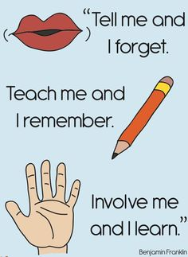

Slide 4
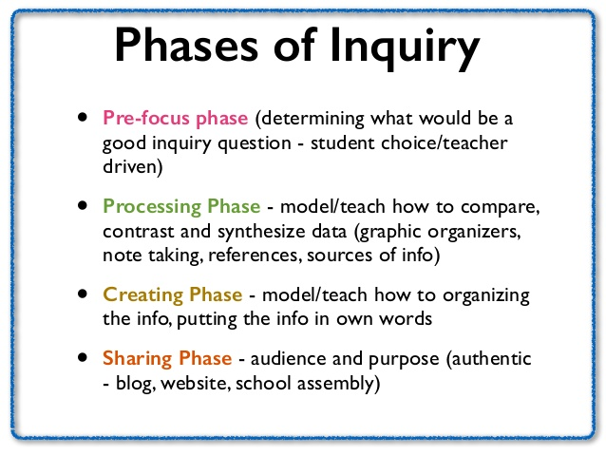
I WONDER…

Slide 5
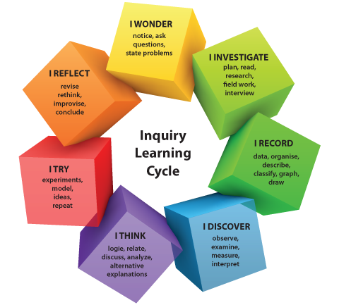

Slide 6
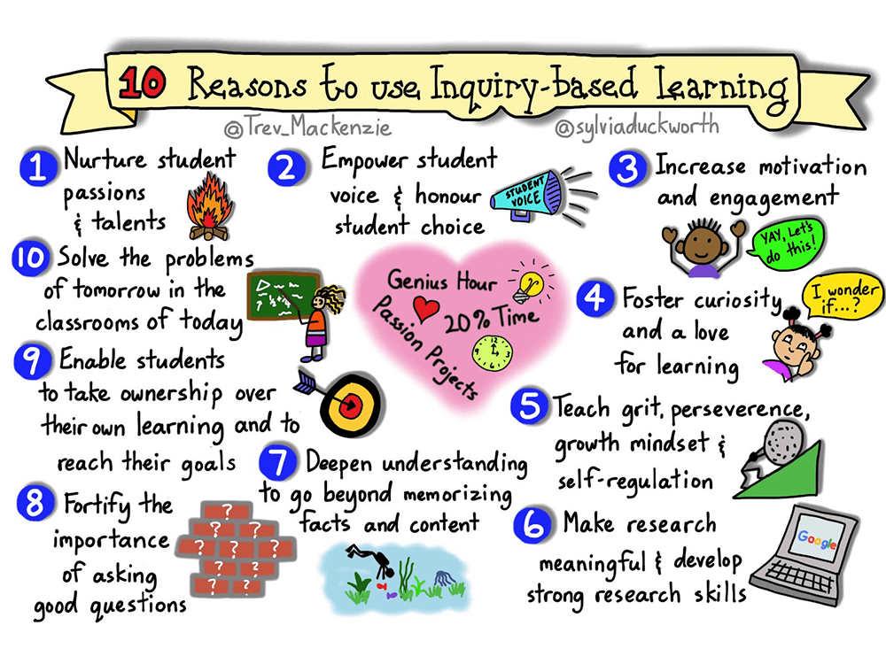

Slide 7
IBL at ANTON GRDINA:
EMPOWERS STUDENT VOICES
INCREASES MOTIVATION AND ENJOYMENT
FOSTERS CURIOSITY AND A LOVE OF LEARNING
ALLOWS SCHOLARS TO TAKE OWNERSHIP OF THEIR LEARNING TO REACH THEIR GOALS

Slide 8
AT ANTON GRDINA, We Inspire We Discover We innovate To achieve academic success
Preparing scholars today to solve the problems of tomorrow

